Slide 1
Automated Data Extraction from Material Science Literature on High Entropy Alloys for Efficient Material Research

Slide 2
Batch A Group 1 - Members
Aman Sirohi CB.EN.U4AIE21003
R. Sriviswa CB.EN.U4AIE21046
Souvik Gorain CB.EN.U4AIE21065
Vikhyat Bansal CB.EN.U4AIE21076
Dr Kritesh Gupta Guide Faculty
2

Slide 3

Problem Statement
3

Slide 4
Problem Statement
To develop an AI-driven framework for analyzing high-entropy alloys (HEAs) {alloys with unique properties} by leveraging large language models (LLMs) to create an integrated question-answering (Q/A) system for precise literature mining.
​
4

Slide 5

Project Phase 1 Overview
5

Slide 6
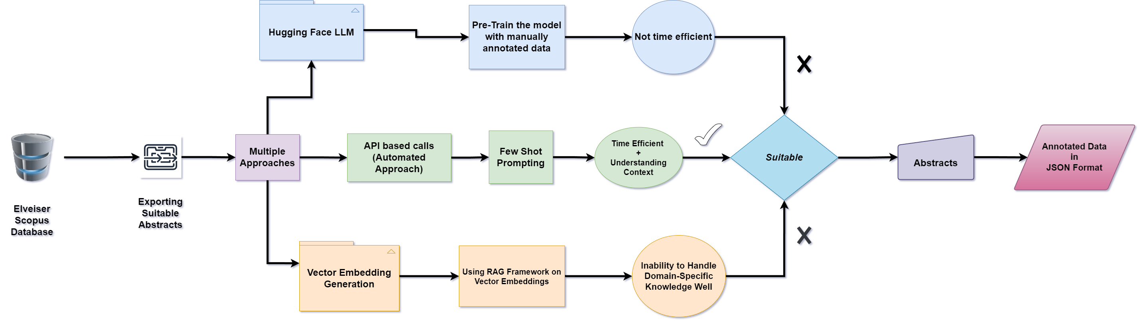
6

Slide 7
Input Abstract
"abstract": "Traditional refractory high-entropy alloys (RHEAs) generally exhibit a trade-off between high-temperature strength and light weight. In present work, a novel design strategy based on tailoring element distribution is proposed to achieve excellent high-temperature strength at a density lower than 7 g cm\u22123. Specifically, a Ti40Nb15Mo30(NbC)15 composite was designed and prepared by powder metallurgy. The composite is found to be composed of two ultrafine-grained (UFG) phases including a body-centered cubic (bcc) solid-solution phase and a face-centered cubic (fcc) ceramic reinforcement phase (Ti, Nb)C. The as-sintered composite shows a uniform and UFG microstructure where two phases are interconnected. Due to this unique microstructure, the Ti40Nb15Mo30(NbC)15 composite displays superb specific yield strengths among surveyed RHEAs, complex concentrated alloys, and metal-matrix composites from 800 \u00b0C (243 MPa g\u22121 cm3) to 1000 \u00b0C (127 MPa g\u22121 cm3). The outstanding high-temperature compressive strength was found to be associated with high resistance to dislocation motion and strong dislocation interactions in both the bcc and fcc phases. The phase interface after hot compression remained semi-coherent, vindicating its high stability. The high-density of stable phase interfaces not only retards the dislocation motion due to the large image force near the phase boundary but also induces a high value of activation energy for diffusion. The high activation energy can further achieve significant microstructure stability even after a long-term annealing (36 h) at 1000 \u00b0C. This work provides new perspectives for the design and application of light and ultrastrong refractory complex concentrated alloys (RCCAs) by comparison to the insufficient strength of many traditional and light RCCAs. \u00a9 2024 Elsevier Ltd"
7

Slide 8
Abstract Result with Other Models
LLM Model Result | RAG Based Model
​{\n \"alloys\": [\n {\n \"name\": \"\",\n \"composition\": {},\n \"microstructure\": {\n \"phases\": \"\",\n \"yield_strength\": {243}\n }\n ],\n \"comparisons\": {\n \"parent_alloys\": []\n },\n \"thermodynamic_calculations\": {\n \"aspects\": [],\n \"\": \n }\n }\n ],\n \"comparisons\": {\n }} | Entities in test text: [('Ti40Nb15Mo30(NbC)15’ ,'Alloy_Composition'), (‘1000 °C', 'Testing_Temperature'), (‘127’,Property)]
8

Slide 9
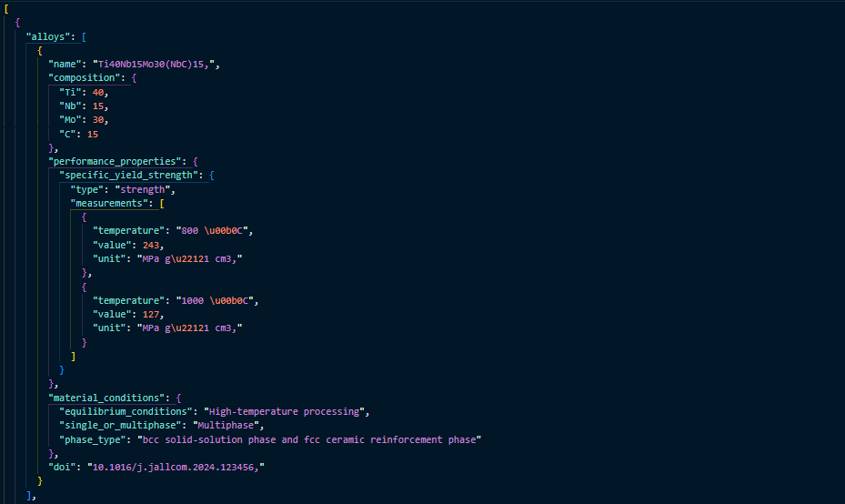
OUTPUT
9

Slide 10
Metric Used
Comparative Analysis: Gold Standard vs. Generated Model Outputs
Confusion Matrix Definitions:
Gold Standard (Actual Prediction): Reference dataset representing ground truth.
Model Output (Predicted Prediction): Generated dataset from computational models.
Confusion Matrix Metrics:
True Positive (TP): Exact match between Gold Standard and Model Prediction.
True Negative (TN): Empty match between both datasets (absence of properties).
False Positive (FP): Empty Gold Standard, non-empty Model Prediction (spurious data).
False Negative (FN): Non-empty Gold Standard, empty Model Prediction (missed data).
Evaluation Approach:
Comparison of five model-generated examples with Gold Standard.
Focus on accurate extraction in structured JSON format, leveraging a post-processing wrapper function.
10

Slide 11
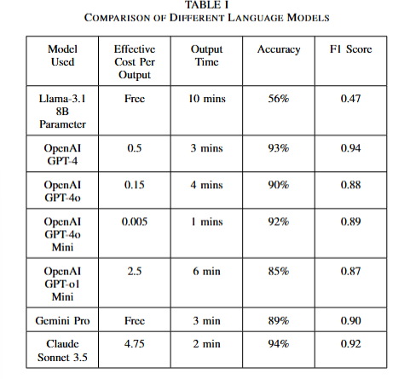
Comparison Done on Various Models
11

Slide 12
Project Phase -2
12

Slide 13
Literature Review
13

Slide 14
Research Paper | Methodology | Limitation Observed
TSQA: Tabular Scenario Based Question Answering Journal: arXiv Computation and Language Authors: Xiao Li,Yawei Sun,Gong Cheng 14 Jan 2021 | The authors created a dataset named GeoTSQA contextualized by tabular scenarios specifically in the geography domain. The task of Tabular Scenario Based Question Answering (TSQA) is defined as synthesizing information from multiple cells in tables and combining it with textual passages and domain knowledge to infer answers to questions. To tackle the TSQA task, the authors introduce a novel component called TTGen (table-to-text generator). This component is responsible for generating sentences from synthesized tabular data, which are then used to inform the downstream MRC methods. | We have observed the following limitation in this paper: As the size of the dataset or the complexity of the scenarios increases, the computational resources required for training and inference may also increase. The GeoTSQA dataset, may not be comprehensive enough to cover the full range of scenarios and complexities found in real-world applications.
14

Slide 15
Research Paper | Methodology | Limitation Observed
FeTaQA: Free-form Table Question Answering Journal: MIT Press Direct Authors: Linyong Nan, Chiachun Hsieh, Ziming Mao, Xi Victoria Lin, Neha Verma 1 Jan 2022 | The authors utilized the ToTTo dataset, which contains textual descriptions grounded in Wikipedia tables, as a starting point for generating question-answer pairs. Their methodology emphasizes generating questions that seek structured information rather than just specific facts. Two main modeli.ng approaches were proposed: 1. Pipeline Model: This model consists of two separate modules: a table semantic parser that retrieves relevant table cells and a Data-to-Text generator that constructs the final answer. 2. End-to-End Model: This approach treats the task as a sequence-to-sequence problem, where the input is a combination of the question and the table, and the output is the free-form answer. | We have observed the following limitation in this paper: Existing datasets primarily focus on short-form answers, which limits the ability to evaluate more complex question-answer interactions that require reasoning and integration of information. The authors observed that some instances in the dataset were difficult to generate questions for, particularly when highlighted cells did not have clear relationships indicating a annotation challenge.
15

Slide 16
Research Paper | Methodology | Limitation Observed
MatSciBERT: A materials domain language model for text mining and information extraction Journal: npj: Computational materials Authors: Tanishq Gupta, Mohd Zaki, N. M. Anoop Krishnan & Mausam 3 May 2022 | This paper introduces Materials Domain Language Model (MatSciBERT) a specialized language model designed for text mining and information extraction within the field of materials science. The pipeline starts by creating a create a comprehensive corpus of materials science literature, known as the Materials Science Corpus (MSC) from relevant research papers. The MatSciBERT model is pre-trained on the MSC. This training process enables the model to learn the nuances of materials science language, including specific terminology, concepts, and relationships between different entities. Once trained, MatSciBERT is used for various downstream tasks like Named Entity Recognition, Relation classification, Abstract classification. | We have observed the following limitation in this paper: The paper notes a scarcity of annotated datasets in the materials While MatSciBERT is designed to be materials-aware, it still relies on the vocabulary of SciBERT, which may not fully capture the unique terminologies and notations specific to materials science.
16

Slide 17
Research Paper | Methodology | Limitation Observed
A general-purpose material property data extraction pipeline from large polymer corpora using natural language processing Journal: npj Computational materials Authors: Pranav Shetty, Arunkumar Chitteth Rajan, Christopher Kuenneth,Sonkakshi Gupta, L. P. Panchumarti, Lauren Holm, Chaoran Zhang, Rampi Ramprasad 27 Sept 2022 | Pipeline mentioned in this paper automates the extraction of material property data from a large collection of research abstracts. It starts by training a specialized language model (MaterialsBERT) on the entire corpus and then filters relevant abstracts. A Named Entity Recognition (NER) model is trained and used to identify key entities like material names, properties, and values. The extracted information is normalized and combined using heuristic rules to generate a structured database of material properties, streamlining the process of data collection for material screening. | We have observed the following limitation in this paper: The process of normalizing polymer names is limited to a predefined dictionary of commonly occurring names. This means that less common polymer names or variations may not be normalized.
17

Slide 18
Research Paper | Methodology | Limitation Observed
AMGPT: a Large Language Model for Contextual Querying in Additive Manufacturing Journal: Arxiv Author: Achuth Chandrasekhar, Jonathan Chan, Francis Ogoke, Olabode Ajenifujah, Amir Barati Farimani 24 May 2024 | This paper introduces "AMGPT," a specialized large language model (LLM) designed to assist materials science researchers with metal additive manufacturing (AM) queries by utilizing a Retrieval-Augmented Generation (RAG) setup. It employs a pre-trained Llama2-7B model to dynamically incorporate information from approximately 50 AM papers and textbooks. | We have observed the following limitation in this paper: This work considers a very limited no. of research papers. Their selection criteria prioritize highly cited sources, which may overlook emerging research or innovative ideas that have not yet gained significant recognition.
18

Slide 19
Objectives
To extend the work from Phase 1 to around 500 abstracts to build the corpus.
To develop an AI-driven framework for analyzing high-entropy alloys (HEAs) {alloys with unique properties} by leveraging large language models (LLMs) to create an integrated question-answering (Q/A) system for precise literature mining.
​
19

Slide 20

Methodology
20

Slide 21
Data Preparation
Output of Phase-1
The JSON file, containing abstracts in a predefined format, is processed to create a dataset in SQuAD format for fine-tuning the model. Q/A samples are generated for each abstract, focusing on two main types of questions: Value-Based and Temperature-Based, with the corresponding context provided for each question. Example for the same are:
Context {"alloys":[{"name":"Ti40Nb15Mo30(NbC)15","composition":{"Ti":40,"Nb":15,"Mo":30,"C":15},"performance_properties":{"specific_yield_strength":{"type":"strength","measurements":[{"temperature":"800 °C","value":243,"unit":"MPa g⁻¹ cm³"},{"temperature":"1000 °C","value":127,"unit":"MPa g⁻¹ cm³"}]}},"material_conditions":{"equilibrium_conditions":"High-temperature processing","single_or_multiphase":"Multiphase","phase_type":"bcc solid-solution phase and fcc ceramic reinforcement phase"},"doi":"10.1016/j.jallcom.2024.123456"}]}
Value Based Q Could you provide the specific yield strength measurement for Ti40Nb15Mo30(NbC)15 at 800 \u00b0C? Temperature Based Q
What temperature conditions were used to measure the specific yield strength of 243 MPa g\u22121 cm3 in Ti40Nb15Mo30(NbC)15?
21

Slide 22
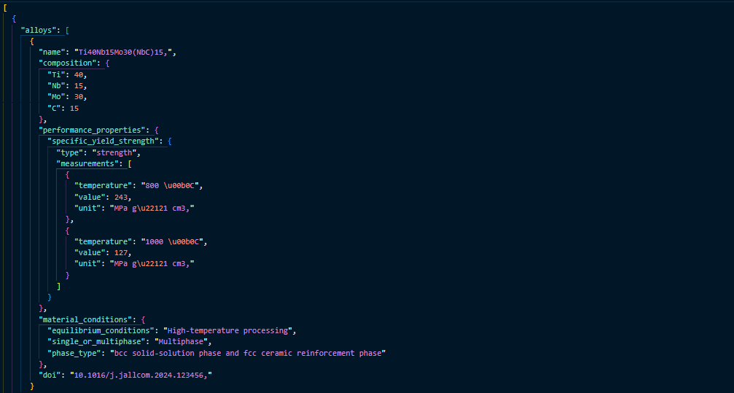
22

Slide 23
Fine-Tuning LLM
We use the generated QnA Dataset to fine-tuned pre-trained Large Language Models (T5, RoBERTa).
T5 | RoBERTa
Developed by: Google Research Architecture: Encoder-Decoder Transformer Trained on: Colossal Clean Crawled Corpus (C4) Strengths: Generates answers (beyond extraction). Excels in generative QA tasks. Unified text-to-text framework enhances flexibility across various NLP tasks. | Developed by: Facebook AI (Meta) Architecture: Transformer Encoder (Like BERT but optimized) Trained on: SQuAD2.0 (Stanford Question Answering Dataset) Strengths: Highly accurate for fact-based OA (extract exact answer spans from context). Faster inference than generative models. Performs well when context is provided.
23

Slide 24
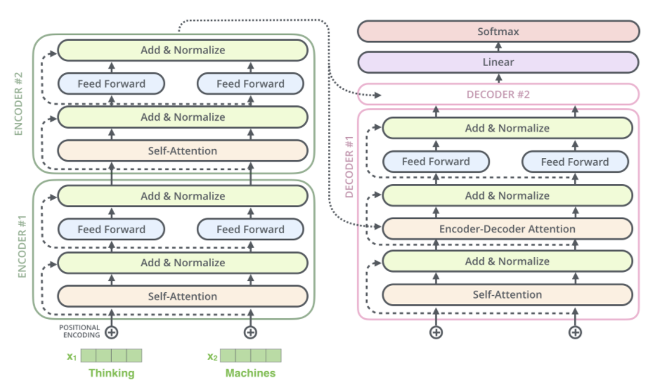
T5-Base
Model Size: 223 M
Layers: 12 + 12
GPU Config: T4
VRAM Usage: 16GB
Training Time(per epoch): 20 mins
Total Training Time: 2 Hours
Epochs: 2
Batch Size: 2
Learning Rate: 0.0001
Optimizer: AdamW
24

Slide 25
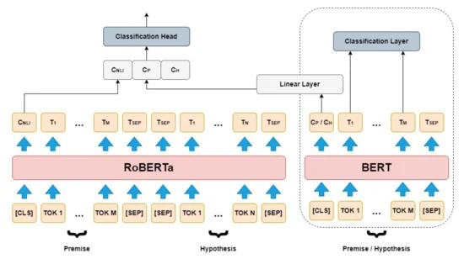
RoBERTa-base-squad2
Model Size: 124 M
Layers: 12
GPU Config: T4
VRAM Usage: 16 GB
Training Time(per epoch): 10-12 mins
Total Training Time: 2Hrs
Epochs: 3
Batch Size: 8
Learning Rate: 0.0001
Optimizer: AdamW
25

Slide 26
Phi-2 with QLoRa
We used Microsoft’s Phi-2, a 2.7B parameter model, to explore large language model potential in materials science. Due to limited computational resources, full finetuning wasn't feasible, so we adopted QLoRA for efficient, low-resource finetuning.
Quantization Implementation:
– The base model was quantized to 4-bit precision using BitsAndBytes
– We employed NF4 (normalized float 4) quantization type for optimal precision
– Double quantization was enabled to further reduce memory requirements
– Computation was performed in FP16 (half precision) for efficiency
26

Slide 27
Phi-2 with QLoRa
LoRA Configuration:
– Rank (r): 8 - defining the dimension of low-rank update matrices
– Alpha: 16 - scaling factor for LoRA updates
– Target modules: attention matrices only (”q proj”, ”k proj”, ”v proj”, ”o proj”)
– LoRA dropout: 0.1 for regularization
– Only 0.1% of the original model parameters were trained, significantly reducing memory requirements
• Training Details:
– Input format: Context followed by question, with the model trained to generate the answer
– Batch size: 4 with gradient accumulation
– Learning rate: 2e-4 with weight decay of 0.001
– Optimizer: 8-bit AdamW
– Training utilized gradient checkpointing for additional memory efficiency
27

Slide 28
Embeddings Generation and Context Retrieval
Data Input:
Loaded from a JSON file containing context, questions, and answers.
Context Embedding:
Each context is encoded using the all-MiniLM-L6-v2 sentence transformer.
FAISS Index:
FAISS (Facebook AI Similarity Search) stores the context embeddings.
Enables fast, scalable nearest-neighbor searches based on cosine similarity.
28

Slide 29
Query Processing and Retrieval
Once FAISS index is built, the retrieval process begins when a user asks a question
Query Embedding:
User questions are encoded with the same sentence transformer.
Context Retrieval:
FAISS performs a cosine-similarity search to retrieve the most relevant context(s).
Pipeline:
Retrieved contexts are passed to the answer generation module.
29

Slide 30
Answer Generation
After retrieving relevant contexts, the model extracts an answer using a fine-tuned model.
Questions are answered through a specialized prompt structure that:
Provides relevant context chunks with clear delineation
Instructs the model to synthesize information across multiple sources
Directs the model to acknowledge conflicts or missing information
30

Slide 31
Output
31

Slide 32
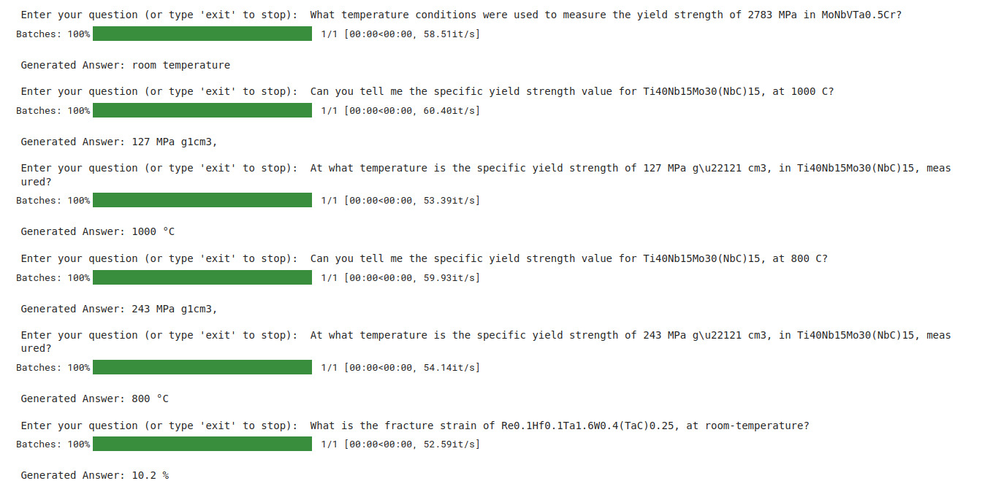
T5
32

Slide 33
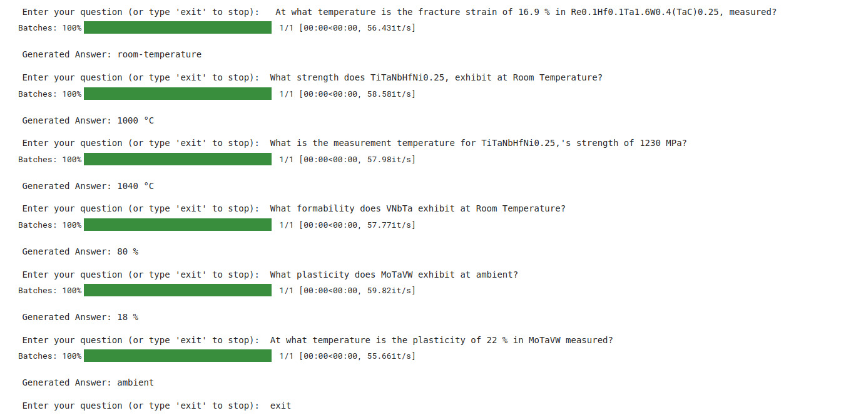
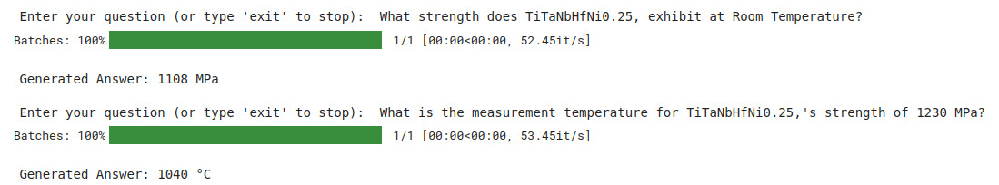
33

Slide 34
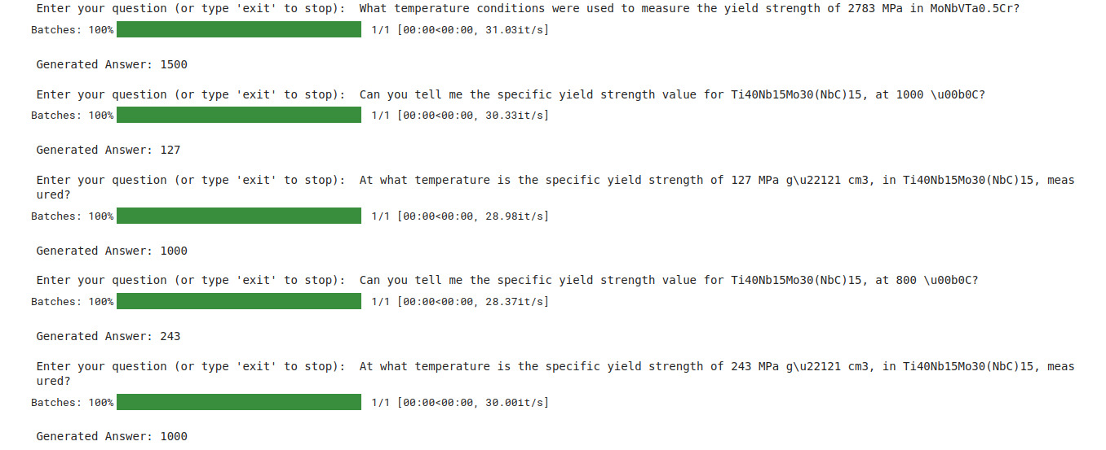
RoBERTa
34

Slide 35
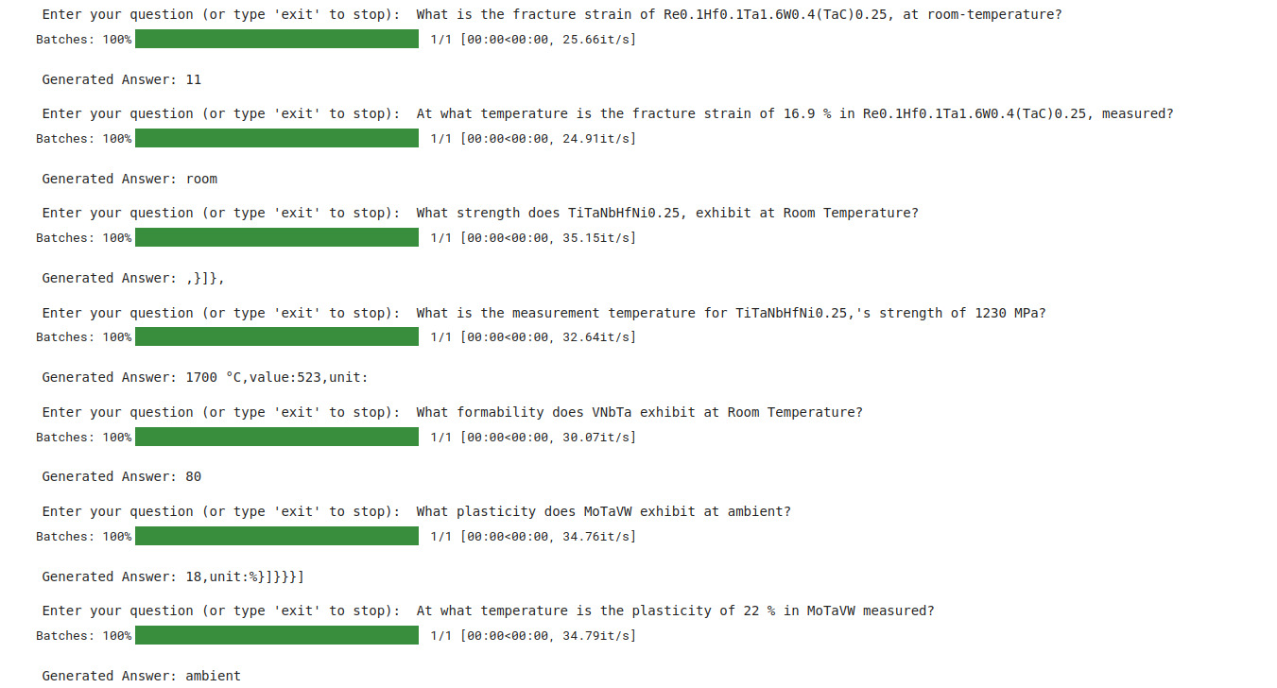
35

Slide 36
Phi-2
36

Slide 37
Evaluation Metrics
Exact Match (EM): Checks if predicted answer exactly matches the ground truth. If prediction exactly matches the ground truth → EM = 1, else EM = 0
int(normalize_answer(pred) == normalize_answer(true))
F1 Score: Measures token overlap between predicted and true answer (harmonic mean of Precision & Recall).
2 * (precision * recall) / (precision + recall)
BLEU Score: Measures how many n-grams (phrases) from the predicted answer appear in the true answer. Measures how similar the predicted answer is to the reference. BLEU considers word order & fluency.
sentence_bleu([true_tokens], pred_tokens)
ROUGE Score: Measures the recall of generated words compared to the reference answer.
Measures word recall (similar to F1 but for longer text generation). ROUGE-L Score: High (good match, even with slight variations).
rouge_evaluator.get_scores(pred, true)["rouge-l"]["f"]
37

Slide 38
Performance Metrics Comparison
Evaluation metrics used | T-5 | RoBERTa | Phi-2
Exact Match | 0.921 | 0.801 | 0.968
F1 score | 0.910 | 0.836 | 0.946
BLEU score | 0.243 | 0.171 | 0.342
ROUGE-L | 0.862 | 0.810 | 0.953
38

Slide 39
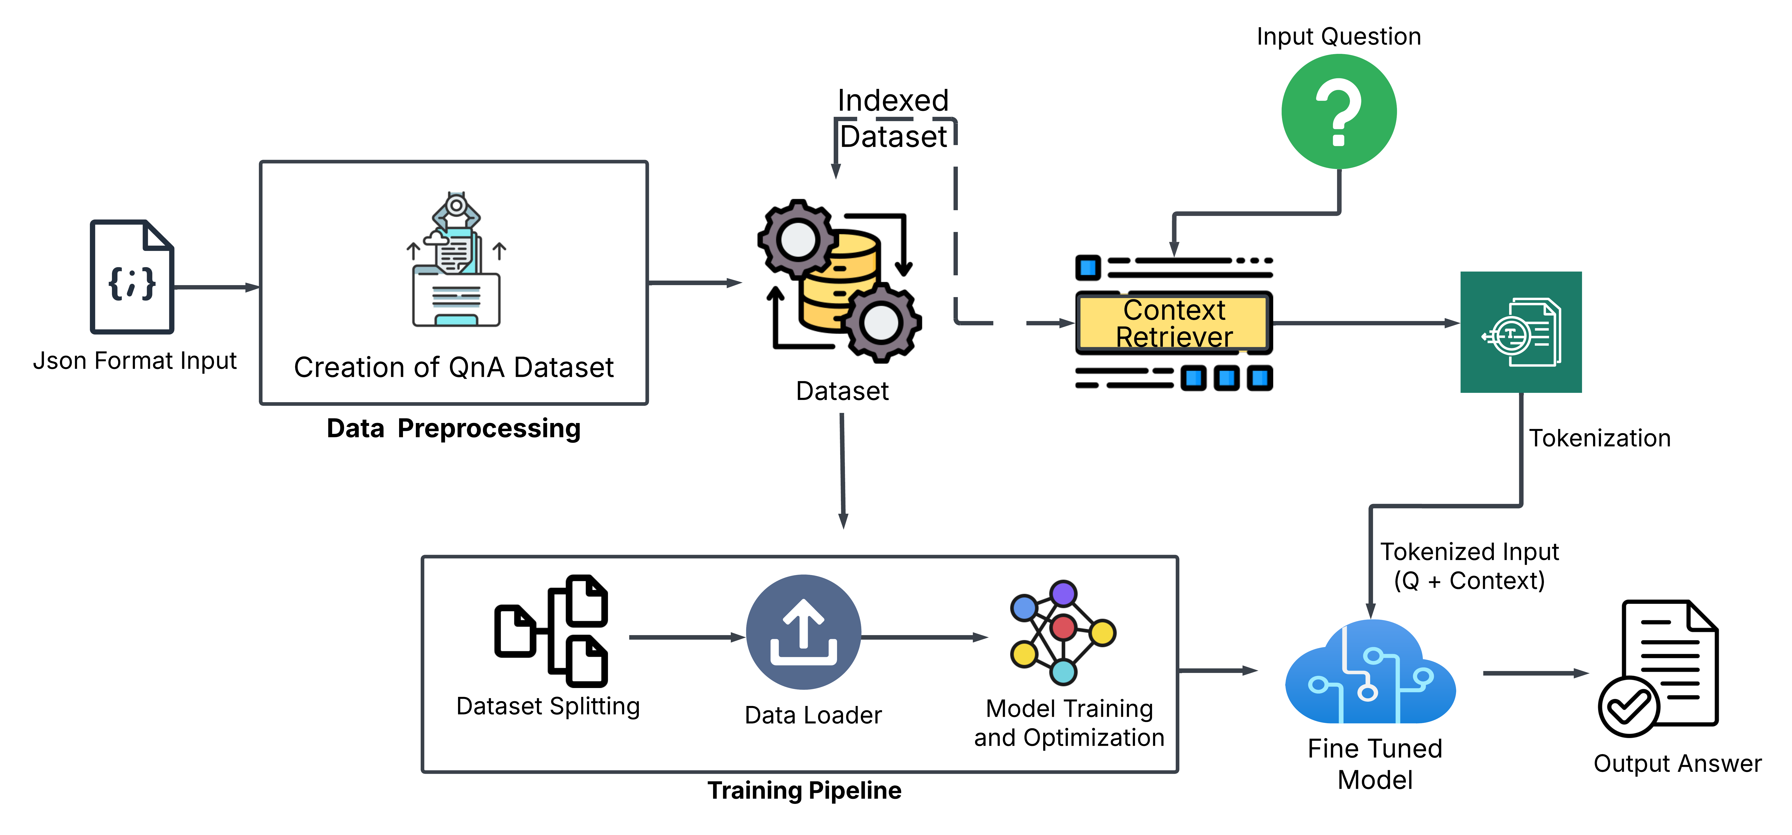
Work Flow
39

Slide 40
QnA Pair Generation
40

Slide 41
Stage-1-Data Preparation
Output of Phase-1
The JSON file, containing abstracts in a predefined format, is processed to create a dataset in which is passed through an INSTRUCT LLM namely ‘Qwen2.5-1.5B’ along with a structured prompt. Q/A are generated for each abstract, focusing on types of categories: Value-Based Temperature-Based Unit-Based Condition Based with the corresponding context provided for each question. :
41

Slide 42
Stage-2-Filtering
QnA Pairs, containing question and answer for a particular context, is processed to create a filtered file containing the most relevant QnA Pair. Two types of filtering is done on the Pairs i.e. Heuristic Filtering and LLM Based Filtering.
In Heuristic Filtering, it filters and cleans Q&A pairs by removing those containing placeholders (e.g., <Value>, <Unit>) and retaining only essential keys (question and answer).
In LLM Based Filtering, it evaluates Q&A pairs based on category alignment, contextual accuracy, and answer quality, assigning a score from 1 to 10. It uses a structured prompt to guide evaluation and extracts the rating from the model’s response, ensuring relevance and correctness for each Q&A pair.
The function filters Q&A pairs by keeping only those with a rating above a given threshold (or a default score of 0).
42

Slide 43
Unbiased Evaluation
Two JSON files are generated: one containing Q&A pairs from Stage 1 and another with filtered Q&A pairs from Stage 2. For evaluation, a selection of Q&A pairs from each file is randomly mixed into a single dataset without indicating their source. Multiple evaluators assess the relevance of each Q&A pair to ensure unbiased marking. Results show that the filtered Q&A pairs consistently outperform the non-filtered ones by approximately 30%, meaning 30% more questions are chosen for the final Q&A set from filtered Q&A pairs from Stage 2.
43

Slide 44
Working Example
Context {"alloys":[{"name":"Ti40Nb15Mo30(NbC)15","composition":{"Ti":40,"Nb":15,"Mo":30,"C":15},"performance_properties":{"specific_yield_strength":{"type":"strength","measurements":[{"temperature":"800 °C","value":243,"unit":"MPa g⁻¹ cm³"},{"temperature":"1000 °C","value":127,"unit":"MPa g⁻¹ cm³"}]}},"material_conditions":{"equilibrium_conditions":"High-temperature processing","single_or_multiphase":"Multiphase","phase_type":"bcc solid-solution phase and fcc ceramic reinforcement phase"},"doi":"10.1016/j.jallcom.2024.123456"}]} Final Q/A Pair
{"Property Value-Based Questions": [{"question":"Retrieve the specific yield strength at 800°C.","answer":"243 MPa g−1 cm³"},{"question":"What is the specific yield strength value at 1000°C?","answer":"127 MPa g−1 cm³"}], "Temperature Based Questions": [{"question":"Under what temperature condition was the specific yield strength measurement made?","answer":"800 °C and 1000 °C"}], "Unit-Based Questions": [{"question":"Identify the unit used for the specific yield strength measurements.","answer":"MPa g−1 cm³"}], "Material Condition Based": [{"question":"Describe the equilibrium conditions for the alloy.","answer":"High-temperature processing"},{"question":"What is the single or multiphase nature of the alloy?","answer":"Multiphase"},{"question":"Explain the phase type of the alloy.","answer":"bcc solid-solution phase and fcc ceramic reinforcement phase"}]}
44

Slide 45
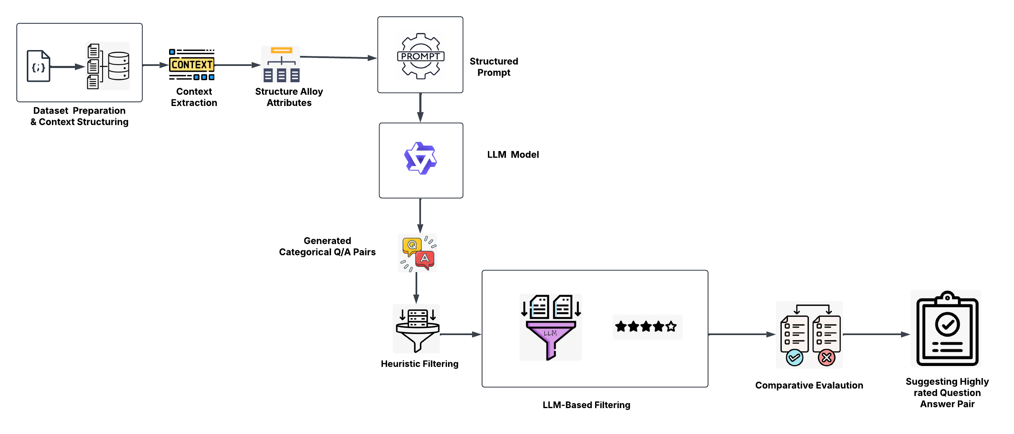
QnA Pairs Generation Pipeline
45

Slide 46
UI
46

Slide 47
UI
Our project culminated in the creation of a web-based application that allows materials scientists to interact with High Entropy Alloy research through an intuitive interface. We’ve integrated our various project components into what we believe is a practical tool for knowledge discovery in this expanding field.
System Architecture and Implementation
Backend: Built with Flask, using Flask-Session for persistent state management.
Core Modules Integrated:
Scientific abstract parsing & structured data extraction
Automated Q-A pair generation
Retrieval-augmented QA with fine-tuned models
Model Deployment:
Local inference: Fine-tuned Phi-2 with QLoRA adapters
API fallback: For high-performance response when resources are limited
47

Slide 48
Data Ingestion and Processing
Multiple Input Formats:
Individual abstract input (text)
Batch upload via CSV
Structured Data Extraction:
Parses compositions, properties, and conditions
Converts to standardized JSON
Organizes into tables for easy analysis
Text Chunking for RAG:
Switched from fixed-length to boundary-aware chunking
Preserves context with 384-token chunks & 64-token overlap
Optimized through experimentation
48

Slide 49
User Interface and Interaction Design
Multi-Modal Data Visualization:
Interactive tables for alloy data
Categorized Q/A display with source highlighting
Data Export Options:
Structured JSON for analysis or databases
Q/A JSON for education or knowledge bases
Asynchronous Processing:
Background tasks with status indicators
Notifications on completion
Accessibility Features:
Dark/light mode toggle
Searchable Q/A sets & responsive design
49

Slide 50
Advanced Features
Model Switching Capability:
Toggle between local fine-tuned Phi-2 and external API
Session Management:
Persistent storage of user data
Auto cleanup & secure handling with unique IDs
Robust Error Handling:
Graceful fallbacks and user-friendly messages
Detailed logs for maintenance and debugging
50

Slide 51
Live Demo
51

Slide 52
Challenges
52

Slide 53
Key System & Model Challenges
Domain-Specific Accuracy
Parsing Complexity: ~90% accuracy on chemical compositions; struggles with ranges, error margins.
Condition Linking Errors: 10% misalignment between properties and conditions.
Conflict Handling: Basic conflict reporting only; lacks cross-paper synthesis.
Terminology Variance: Inconsistent terms (e.g., "yield strength" vs. "yield stress") complicate extraction.
Dataset & Representation
Limited QA Dataset: Only ~250 samples fine-tuned.
Numerical Challenges: Difficulty in precise numerical relationships.
Context Limits: 512-token window restricts full detail inclusion.
53

Slide 54
Technical & Deployment Limitations
Model Fine-Tuning
Compute Constraints: Phi-2 finetuning limited by hardware (OOM errors).
Catastrophic Forgetting: T5 lost generalization after aggressive tuning.
Overfitting: RoBERTa showed early overfitting signs (2–4 epochs).
Inference & Deployment
Slow Inference: 1–1.5 min per answer on CPU.
Retrieval Issues: 12% context mismatches due to FAISS limitations.
Flask Concurrency: Single-threaded, bottlenecks under multi-user load.
Client Performance: UI lag on low-end devices with large result sets.
54

Slide 55
Timeline
55

Slide 56
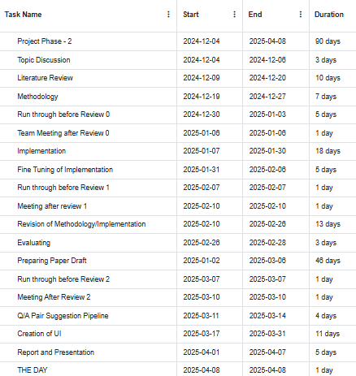
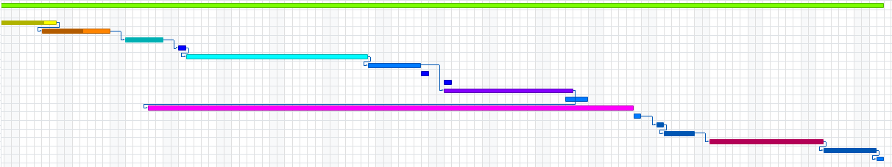
56
Notes:
https://www.onlinegantt.com

Slide 57
References
57

Slide 58
Some of the References
[1] Schmid, U. (2022). MatSciBERT: A materials domain language model for text mining and information extraction. npj Computational Materials, 8(1).
[2] Song, Z., Lu, S., Zhou, Q., Wang, J. (2024). T2MAT (text-to-materials): A universal framework for generating material structures with goal properties from a single sentence. Cornell University. [3] Shetty, P., Rajan, A. C., Kuenneth, C., Gupta, S., Panchumarti, L. P., Holm, L., Zhang, C., Ramprasad, R. (2022). A general-purpose material
property data extraction pipeline from large polymer corpora using
natural language processing. npj Computational Materials, 9(1).
[4] Kritesh Kumar Gupta, Surajit Das Barman, S Dey, Susmita Naskar,T.
Mukhopadhyay. (2024). On exploiting nonparametric kernel-based probabilistic machine learning over the large compositional space of high entropy alloys for optimal nanoscale ballistics. *Dental Science Reports*, 14(1). Nature Portfolio.
58

Slide 59
Links of Resources used
Overleaf Paper Link: https://www.overleaf.com/9685192699rfwhcbffwnss#ee21af Dataset Link: Google Notebook: Google Colab Gantt Source: https://www.onlinegantt.com/#/gantt PyTorch Lightning: https://lightning.ai/docs/overview/getting-started
Project_Phase_2_Files
59

Slide 60
Thank You!!

